Slide 1

Permutations & Combinations

Slide 2
Learning Objectives
Fundamental Principles Counting.
Arrangement - Linear & Geometrical.
Selection, Grouping and Distribution.

Slide 3
Two Fundamental Principles of Counting
Event A → can occur in m ways.
Event B → can occur in n ways.
Sum Rule – (A or B) → can occur in m + n ways.
Product Rule – A and B → can occur in m × n ways.

Slide 4



Definition
Permutation - Arrangement in a definite order of number of objects taken some or all at a time. Order of things is very important.
E.g.- Passwords, Arranging people, Digits, Alphabets, Colours etc.
Combination – A selection that can be formed by taking some or all a finite set of things or objects. Order is not important.
E.g.- Selection of Teams, Subjects, Menu, Items etc.

Slide 5

Basic Formulae
^{n}P_{r} → Number of arrangements of 'n' different objects taken 'r' at a time
^{n}P_{r} $=$ n(n−1)(n−2)...(n−r +1) = $\frac{n!}{\left(n −r\right)!}.$
^{n}C_{r} → Number of selections of 'n' different objects taken 'r' at a time.
^{n}C_{r} = $\frac{\text{n}\text{(}\text{n}\text{−1)(}\text{n}\text{−2)...(}\text{n}\text{−}\text{r}\text{ +1)}}{r!}= \frac{n!}{r! \left(n −r\right)!}=$ $\frac{\text{n}\text{P}\text{r}}{r! }$ = ^{n}C_{n-r.}

Slide 6
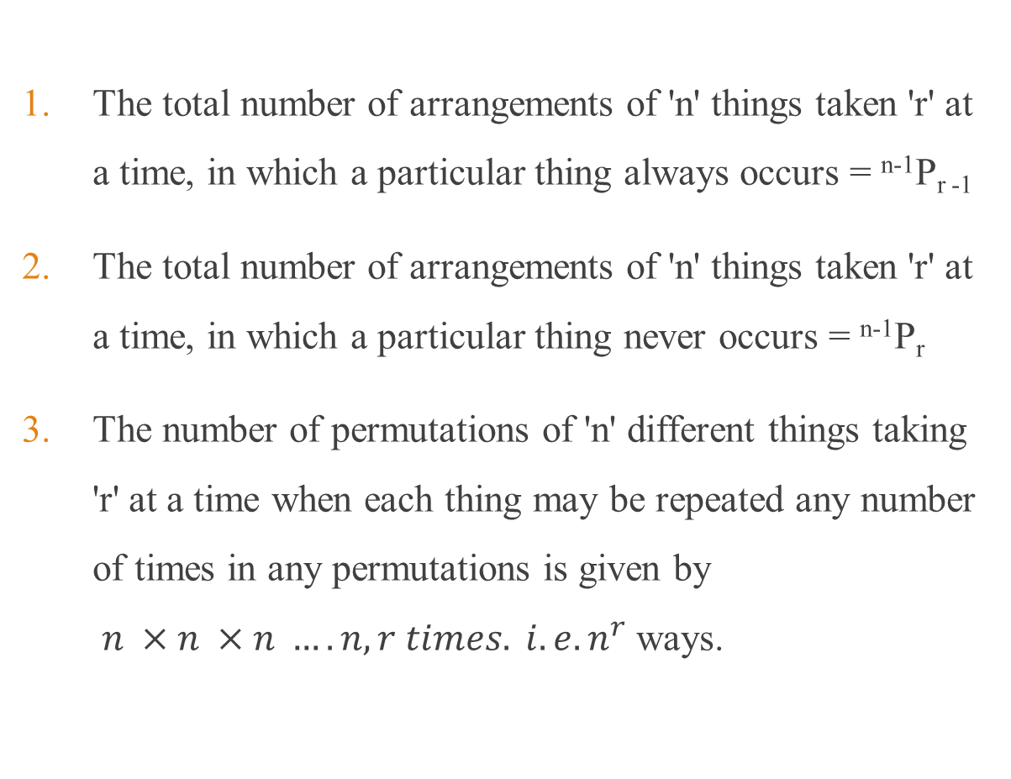
Permutations under constraints
The total number of arrangements of 'n' things taken 'r' at a time, in which a particular thing always occurs = ^{n-1}P_{r -1}
The total number of arrangements of 'n' things taken 'r' at a time, in which a particular thing never occurs = ^{n-1}P_{r}
The number of permutations of 'n' different things taking 'r' at a time when each thing may be repeated any number of times in any permutations is given by $n ×n ×n ….n, r times. i.e. n^{r}$ways.

Slide 7
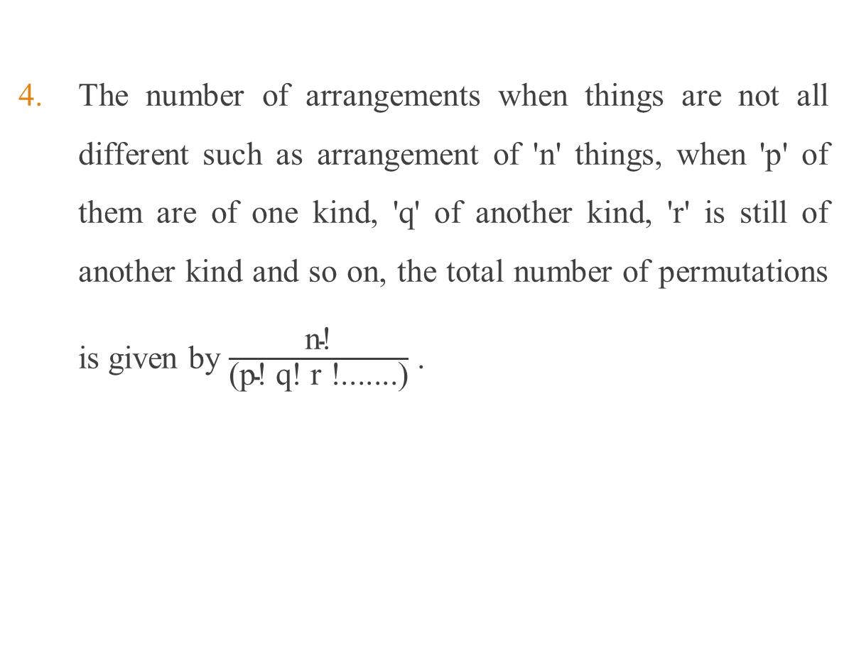
Permutations under constraints
The number of arrangements when things are not all different such as arrangement of 'n' things, when 'p' of them are of one kind, 'q' of another kind, 'r' is still of another kind and so on, the total number of permutations is given by $\frac{\text{n}\text{!}}{\text{(}\text{p}\text{! }\text{q}\text{! }\text{r}\text{ !.......)}}$ .

Slide 8
Combinations under constraints
Number of combinations of n different things taken 'r' at a time in which 'p' particular things will always occur is ^{n-p} C_{r-p}
Number of combinations of n dissimilar things taken 'r' at a time in which 'p' particular things will never occur is ^{n-p} C_{r}
The number of ways in which (m + n) things can be divided into two groups containing m & n things respectively ^{m+n} C_{m} = ^{m+n} C_{n.}

Slide 9
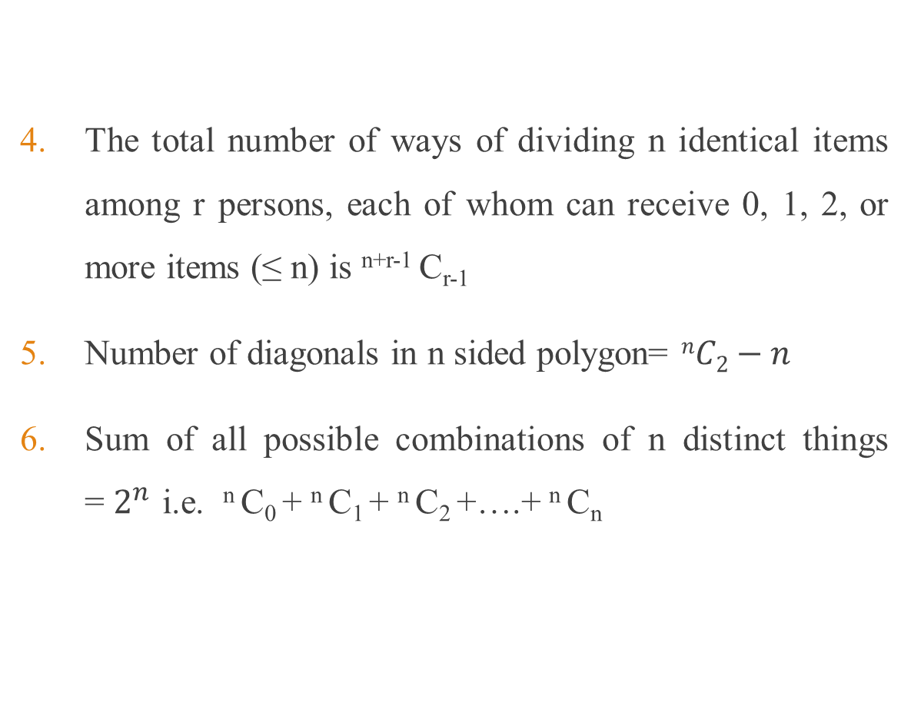
Combinations under constraints
The total number of ways of dividing n identical items among r persons, each of whom can receive 0, 1, 2, or more items (≤ n) is ^{n+r-1} C_{r-1}
Number of diagonals in n sided polygon= $nC2−n$
Sum of all possible combinations of n distinct things = $2^{n}$ i.e. ^{n} C₀ + ^{n} C₁ + ^{n} C₂ +….+ ^{n} C_{n}

Slide 10
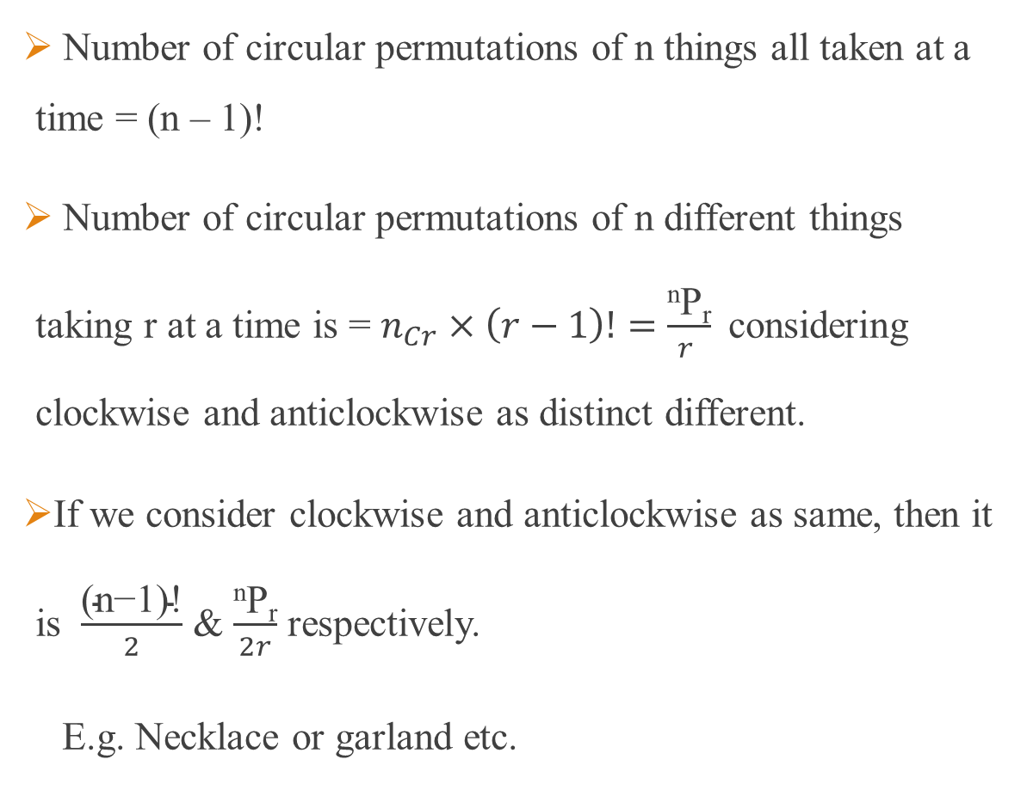
Geometrical Arrangements Circular Arrangements
Number of circular permutations of n things all taken at a time = (n – 1)!
Number of circular permutations of n different things taking r at a time is = $n_{Cr}×\left(r−1\right)!=$ $\frac{\text{n}\text{P}\text{r}}{r }$considering clockwise and anticlockwise as distinct different.
If we consider clockwise and anticlockwise as same, then it is $\frac{\text{(}\text{n}\text{−1)!}}{2}$ & $\frac{\text{n}\text{P}\text{r}}{2r}$ respectively.
E.g. Necklace or garland etc.

Slide 11
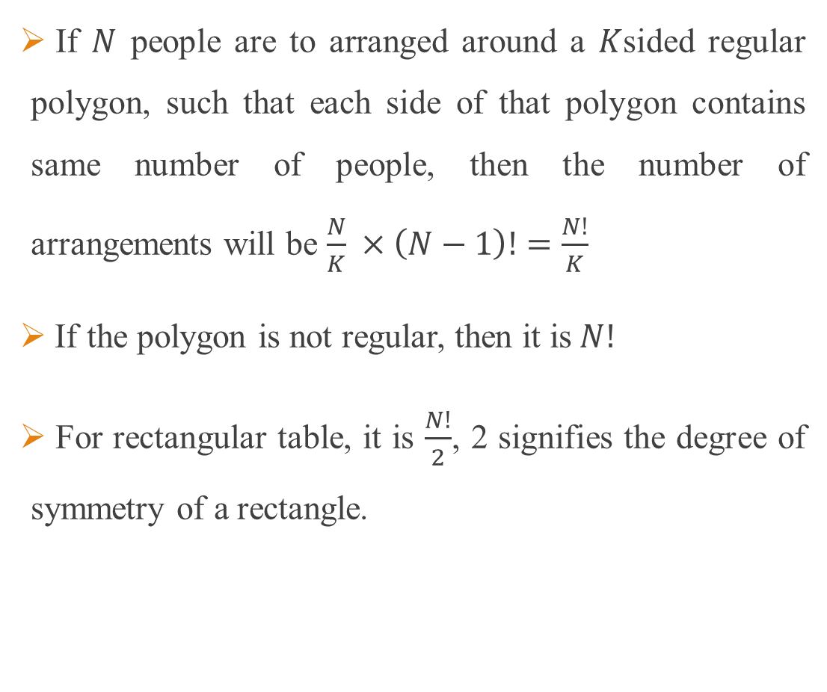
Geometrical Arrangements Arrangement around a regular polygon
If $N$ people are to arranged around a $K$sided regular polygon, such that each side of that polygon contains same number of people, then the number of arrangements will be $\frac{N}{K} ×\left(N−1\right)!=\frac{N!}{K}$
If the polygon is not regular, then it is$N!$
For rectangular table, it is $\frac{N!}{2}$, 2 signifies the degree of symmetry of a rectangle.

Slide 12
Example 1
How many four-digit numbers can be formed from the digits 2, 3, 5, 6, 7 & 9 which are divisible by 4 and none of the digits is repeated?
A. 96 B. 88 C. 80 D. 144
Solution: Option A
The last two digits of the number must be 32, 36, 52, 56, 72, 76, 92, 96.
_ _ _ _
4 × 3 × 8 = 96.

Slide 13
Example 2
How many 4-digit numbers divisible by 5 can be formed with the digits 0, 1, 2, 3, 4, 5, 6 and 6? (Repetition not allowed, means only 6 can be used 2 times).
A. 220 B. 249 C. 216 D. 288
Solution:
÷5, 4-digit number _ _ _ _ using 0, 1, 2, 3, 4, 5, 6 & 6.
Case I – 0/1 six
_ _ _ 0 (6×5×4×1=120)
_ _ _ 5 (5×5×4×1=100).
So 220 numbers are there with either 1 or 0 six.

Slide 14
Example 2 Cont.
Case II – 2 sixes
_ _ _ 0 (5C1×3)
_ _ _ 5 (5C1×3 – 1).
So 15+14 = 29 numbers with 2 sixes.
Total 220 + 29 = 249.
Option B.

Slide 15
Example 3
In how many ways can the letters of the word "OPTICAL" be rearranged such that vowels are always together?
A. 120 B. 720 C. 2140 D. 5360
Solution: Option B.
Consider the vowels OIA as a single entity.
So arranging PTCL + OIA = (4+1)! × 3! = 720.

Slide 16
Example 4
In how many ways can the letters of the word "OPTICAL" be arranged such that vowels are never together?
A. 720 B. 7! – 720 C. 2140 D. 1440
Solution: Option D
First place the consonants, and then place the vowels in between them.
_ P _ T _ C _ L _.
So PTCL can be arranged in 4! & 3 vowels in the 5 gaps in ⁵P₃ ways.
Hence 24 × 5 × 4 × 3 =1440.

Slide 17
Example 5
There are 20 people among whom 2 are sisters. Find the number of ways in which we can arrange them around a circle so that there is exactly one person between the 2 sisters.
A. 18! B. 2! × 19! C. 19! D. 2! × 18!
Solution:
Select 1 guy to sit between the 2 sisters, 18C1 ways.
Now 17 guys + S1_S2 = 18, can be arranged in a circular table in (18-1)! = 17! ways.
Also the sisters can exchange their positions, 2! ways.
Hence 2 × 18 × 17! = 2 × 18! ways.
Option D.

Slide 18
Example 6
If you jumble and arrange the word LABOUR in all possible ways and arrange all the words so formed as in a dictionary. What will be the rank of the word LABOUR?
Solution:
The alphabetical order is A B L O R U.
A _ _ _ _ _ = 5! = 120,
B _ _ _ _ _ = 5! = 120,
L A B O R U
L A B O U R.
So the rank is 120 + 120 + 1 + 1 = 242.

Slide 19
Example 7 Distribution problem
In how many ways can 5 Chocolates be distributed among 3 Kids such that
The Chocolates are different.
The Chocolates are identical.
The Chocolates are different, but given to triplets (identical children)
The Chocolates are identical, and given to triplets (identical children)
(Each children is eligible to get all 5 chocolates)

Slide 20
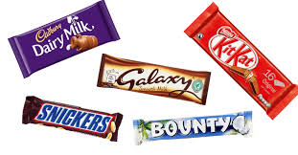


Example 7 (i)
In how many ways can 5 different Chocolates be distributed among 3 Kids.
Chocolate 1 can be given to Kid_{1,} Kid₂ or Kid_{3,} 3 ways.
C₁ C₂ C₃ C₄ C₅
K₁ K₂ K₃
Similarly each chocolates can be distributed in 3 ways.
Hence 3 × 3 × 3 × 3 × 3 = $3^{5}$= 243 ways.

Slide 21

Example 7 (i) - Aliter
5 Different chocolates to 3 kids
(5, 0, 0) → $5C5$ × $3C1$ = 1 × 3 = 3 ways.
(4, 1, 0) → $5C4$ × $3C1 \text{×} 1C1$ × $2C1$= 5 × 3 × 1 × 2 = 30 ways.
(3, 2, 0) → $5C3$ × $3C1 \text{×} 2C2$ × $2C1$= 10 × 3 × 1 × 2 = 60 ways.
(3, 1, 1) → $5C3$ × $3C1 \text{×} \frac{2C1\text{× }2C1}{2}$ = 10 × 3 × $\frac{2 \text{× }2}{2}$ = 60 ways.
(2, 2, 1) → $5C2$ × $3C1 \text{×} \frac{3C2\text{× }2C1}{2}$ = 10 × 3 × $\frac{6 \text{× }2}{2}$ = 90 ways.
Hence total 243 ways.

Slide 22
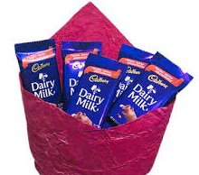
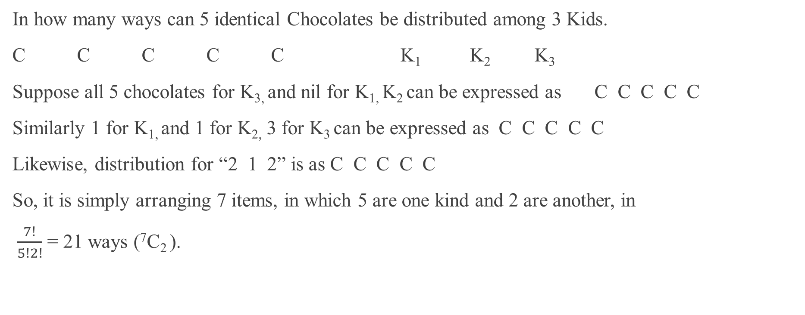
Example 7(ii)
In how many ways can 5 identical Chocolates be distributed among 3 Kids.
C C C C C K₁ K₂ K₃
Suppose all 5 chocolates for K_{3,} and nil for K_{1,} K₂ can be expressed as C C C C C
Similarly 1 for K_{1,} and 1 for K_{2,} 3 for K₃ can be expressed as C C C C C
Likewise, distribution for “2 1 2” is as C C C C C
So, it is simply arranging 7 items, in which 5 are one kind and 2 are another, in
$\frac{7!}{5!2!}$ = 21 ways (⁷C₂ ).

Slide 23

Example 7(ii) - Aliter
In how many ways can 5 identical Chocolates be distributed among 3 Kids.
(5, 0, 0) → $\frac{3!}{2!}$ = 3 ways.
(4, 1, 0) → $3!$= 6 ways.
(3, 2, 0) → $3!$= 6 ways.
(3, 1, 1) → → $\frac{3!}{2!}$ = 3 ways.
(2, 2, 1) → → $\frac{3!}{2!}$ = 3 ways.
Hence total 21 ways

Slide 24


Example 7(iii)
5 Different chocolates to Triplets
(5, 0, 0) → $5C5$ × $1$ = 1 way.
(4, 1, 0) → $5C4$ × $1C1$= 5 ways.
(3, 2, 0) → $5C3$ × $2C2$ = 10 ways.
(3, 1, 1) → $5C3$ $\text{×} \frac{2C1}{2}$ = 10 ways.
(2, 2, 1) → $5C2$ $\text{×} \frac{3C2}{2}$ = 15 ways.
Hence total 41 ways.

Slide 25
Example 8
The number of non-negative integral solutions of the equation a + b + c + d = 20 is
A. 1208 B. 4024 C. 1140 D. 1771
Solution:
The total number of ways of dividing n identical items among r persons, each of whom can receive 0, 1, 2, or more items (≤ n) is ^{n+r-1} C_{r-1.}
Here n = 20, r = 4.
²⁰⁺⁴⁻¹ C₄₋₁ = ²³ C₃ = 1771.
Option D.

Slide 26

Example 9-Envelope problem
There are 4 different letters and 4 addressed envelopes. In how many ways can the letters be put in the envelopes so that at least one letter goes to the correct address?
Solution: Total – No letter goes to right envelope = at least one letter goes right envelope
✓ × Ways
4 0 1
3 1 0
2 2 6 1 3 8 0 4 9.
Hence 24 – 9 = 15

Slide 27
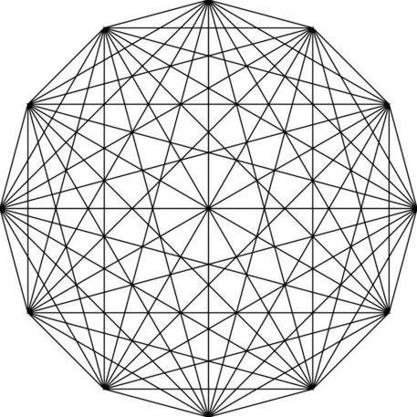
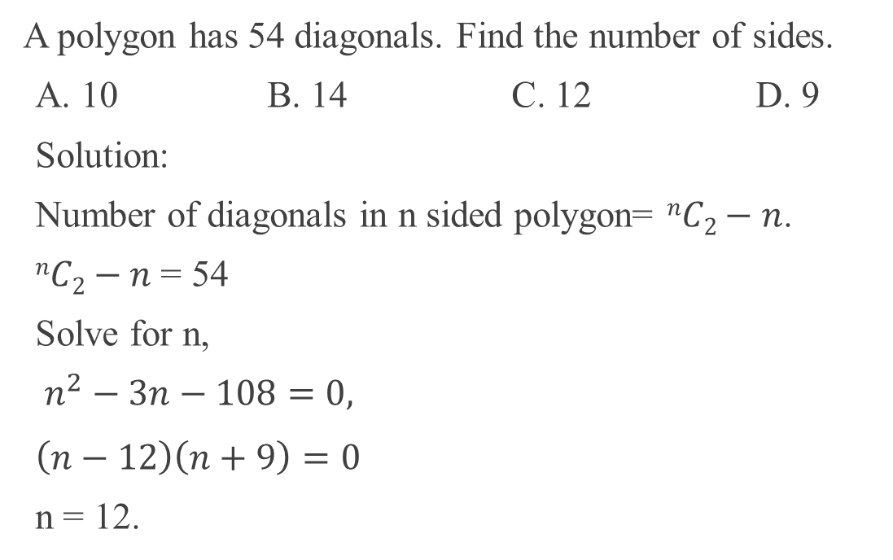
Example 10-Diagonal problem
A polygon has 54 diagonals. Find the number of sides.
A. 10 B. 14 C. 12 D. 9
Solution:
Number of diagonals in n sided polygon= $nC2−n$.
$nC2−n$ = 54
Solve for n,
$n^{2}−3n−108=0,$
$\left(n−12\right)\left(n+9\right)=0$
n = 12.

Slide 28
Thank you
Narayanan RS CIR

